Slide 1

KGiSL INSTITUTE OF TECHNOLOGY
COIMBATORE
DEPARTMENT OF computer science & engineering
MINI Project FINAL revieW
AI BASED CHATBOT TO ANSWER FAQs
TEAM MEMBERS:
711719104057 Newtton Habukuk S
711719104079 Sanjay K
711719104097 Suveksha A
711719104100 Thanusu C
Under the guidance of :
Ms. Aruna T N, AP/CSE

Slide 2

agenda
Abstract
Existing System
Proposed System
Module Splitup
Conclusion
Future Enchancements
References
Timeline

Slide 3
abstract
AI chatbot to answer college related queries like admissions, course details, etc, using Artificial Intelligence and Machine Learning algorithms. Integrate the chatbot into a website with authentication capabilities.

Slide 4
EXISTING SYSTEM
Information pertaining to college activities, notices, exam dates, admission and scholarship questions were only available through college notice boards, WhatsApp groups related to the college, by college websites, or by a personal visit to the college.
DRAWBACKS OF EXISTING SYSTEM
Deficit in informing non-college members about the college and its daily activities.
Separate group of people as centre point of communication for clearing doubts related to college.

Slide 5
Literature survey
SNo | Published Year | Paper Title | Authors | Technology
1 | 2021 | Dexter the College FAQ Chatbot | Ajinkya Huddar; Chaitanya Bysani; Chintan Suchak; Uttam D Kolekar; Kaushiki Upadhyaya | RASA, machine learning, LSTM, RNN
2 | 2020 | University Chatbot using Artificial Intelligence Markup Language | Naing Naing Khin; Khin Mar Soe | AIML, Natural Language Processsing, Pandorabots
3 | 2019 | AI and Web-Based Human-Like Interactive University Chatbot (UNIBOT) | Neelkumar P. Patel; Devangi R. Parikh; Darshan A. Patel; Ronak R. Patel | Artificial Intelligence,Chatbot, Machine Learning
4 | 2018 | Dinus Intelligent Assistance (DINA) Chatbot for University Admission Services | Heru Agus Santoso; Nurul Anisa Sri Winarsih; Edy Mulyanto; Galuh Wilujeng saraswati; Septian Engg | Chatbot,ontology, Neural network,NLP
5 | 2017 | Chatbot for University Related FAQs | Bhavika R. Ranoliya_, Nidhi Raghuwanshi_ and Sanjay Singh | Artiﬁcial Intelligence Markup Language (AIML) and Latent Semantic Analysis (LSA)

Slide 6
PROPOSED SYSTEM
Creating a chatbot to answer questions related to college such as admissions, course details, etc, using AI and machine learning algorithms. Integrating the developed chatbot into a website with authentication capabilities.
ADVANTAGES OF PROPOSED SYSTEM
Authentication feature in the website
Information's are easily accessible
Chabot's are more reliable

Slide 7
Architectural Diagram
HOW A CHAT BOT WORKS
Chatbot platform
Resides on the system
Language
parsing
Natural
language
question
Natural language
process
Knowledge
base
User
Bot Engine
Login
credentials
Natural
language
answer
Data storage
Store details
Verification result

Slide 8
Modules split up
Module 1 : Designing webpage and chatbot
Module 2 : Training the chatbot
Module 3 : Integrating chatbot into the website
Module 4 : Integrating chatbot with database

Slide 9
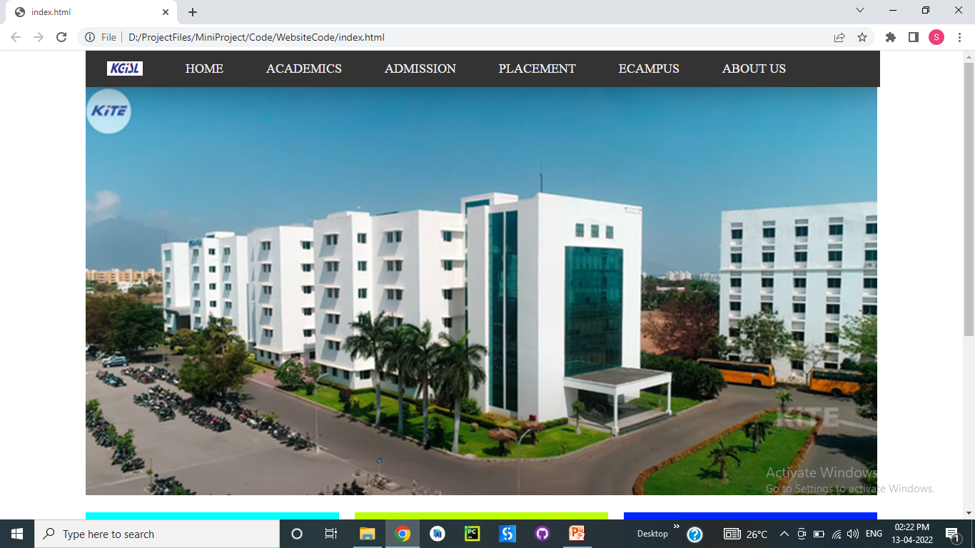
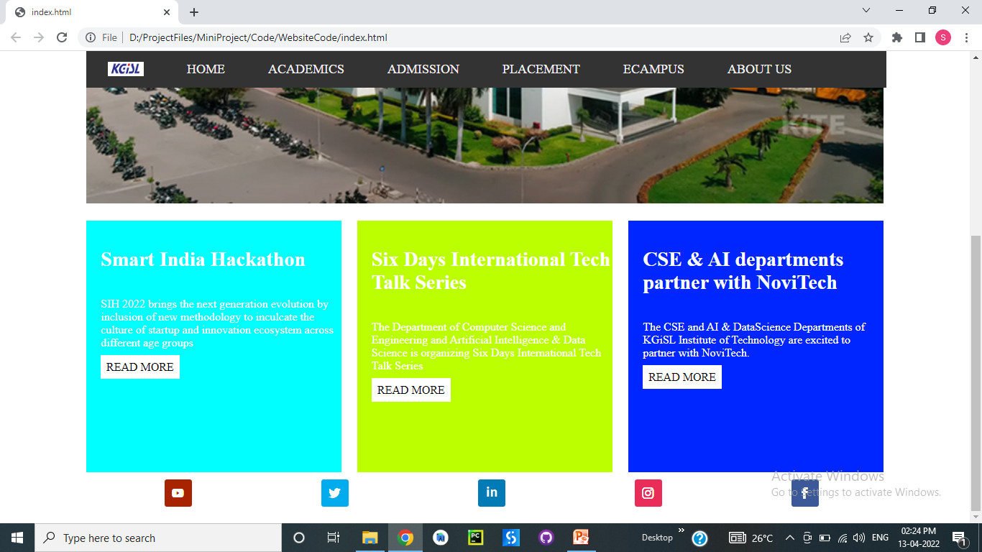
module 1- Designing webpage

Slide 10
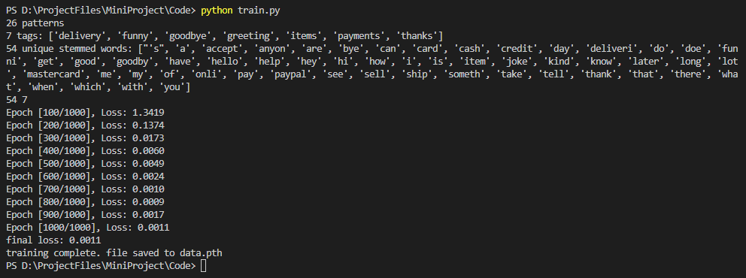
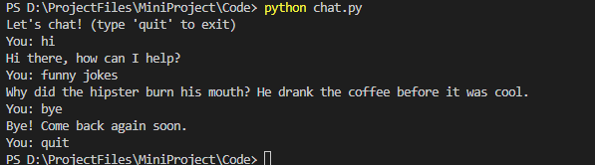
Module 1- designing CHATBOT

Slide 11
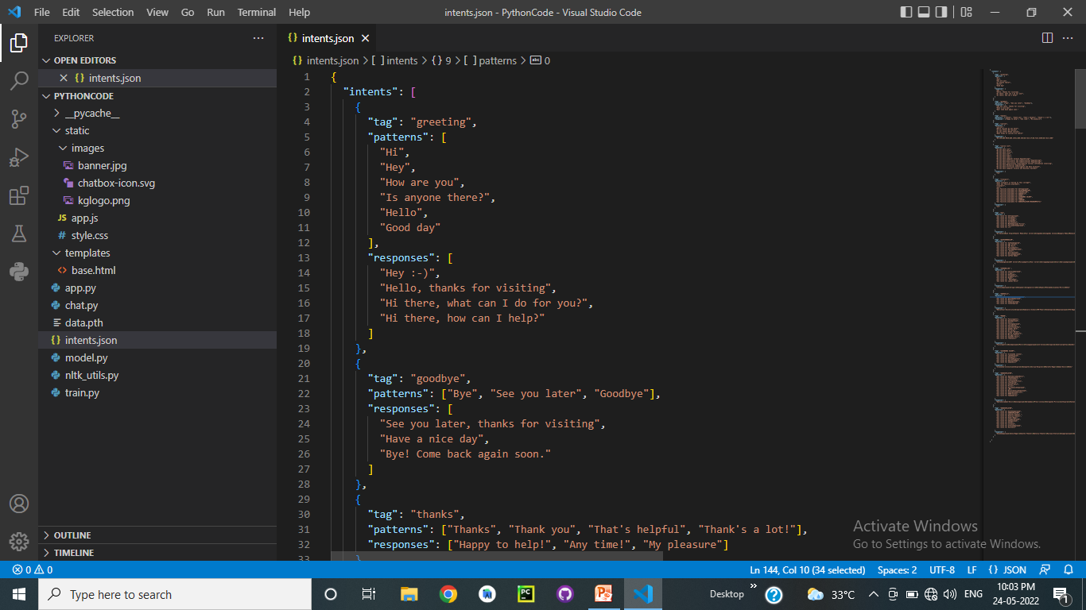
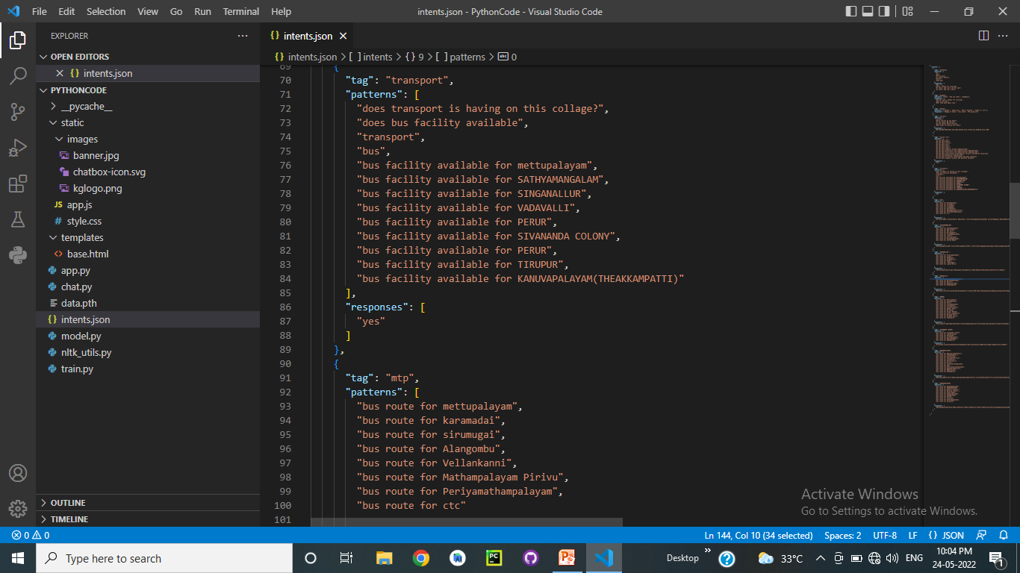
module 2 – training the chatbot

Slide 12
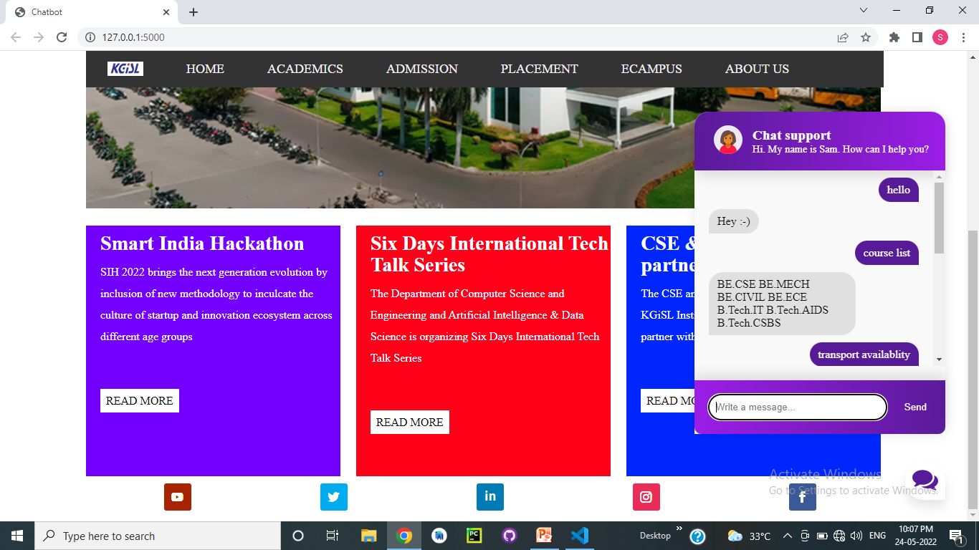
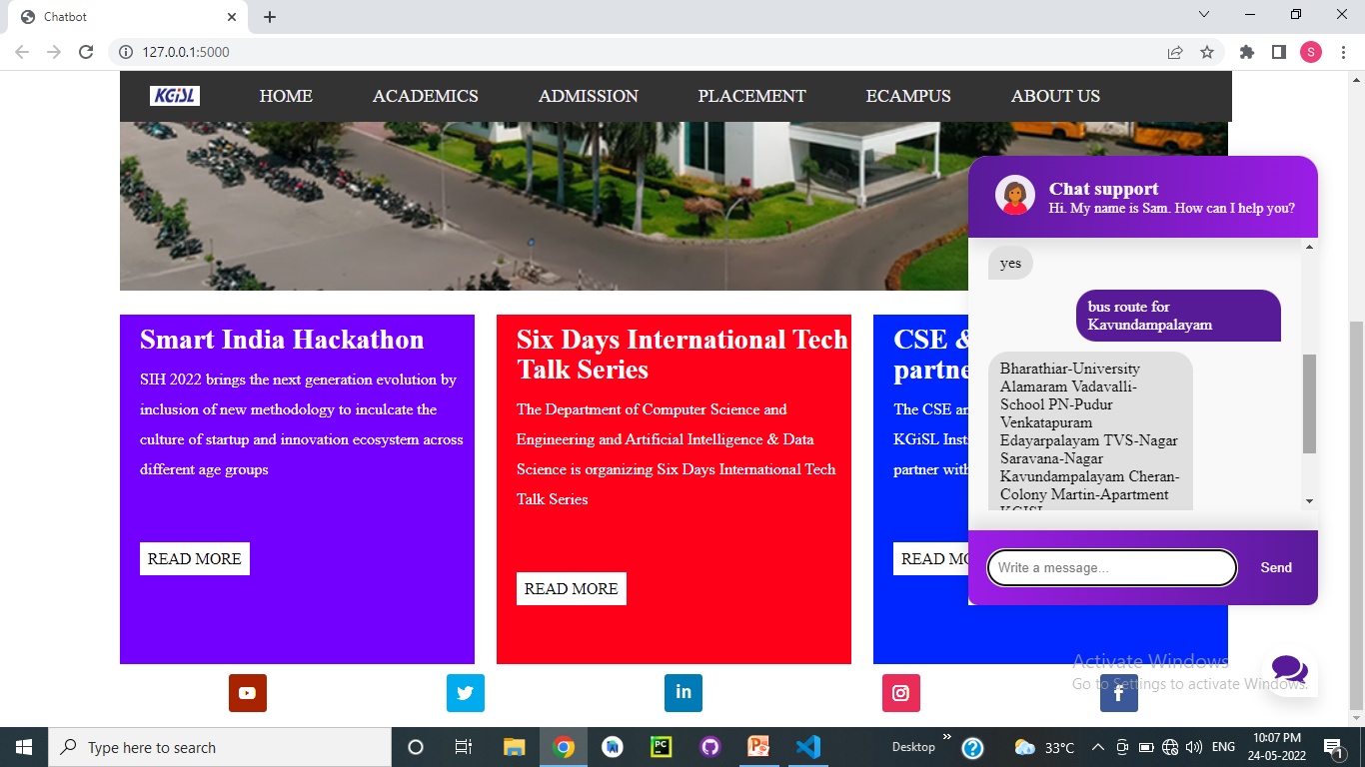
module 3 - integrating chatbot into website

Slide 13
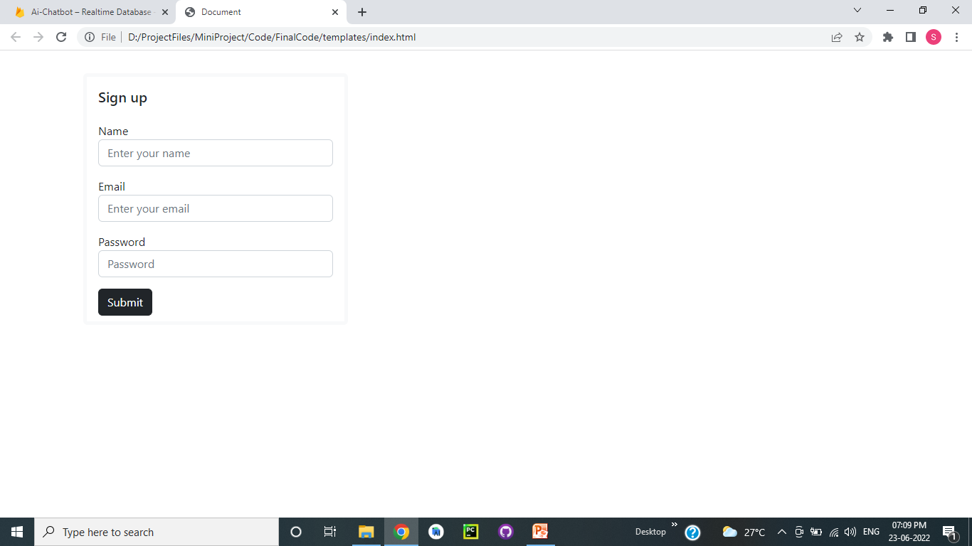
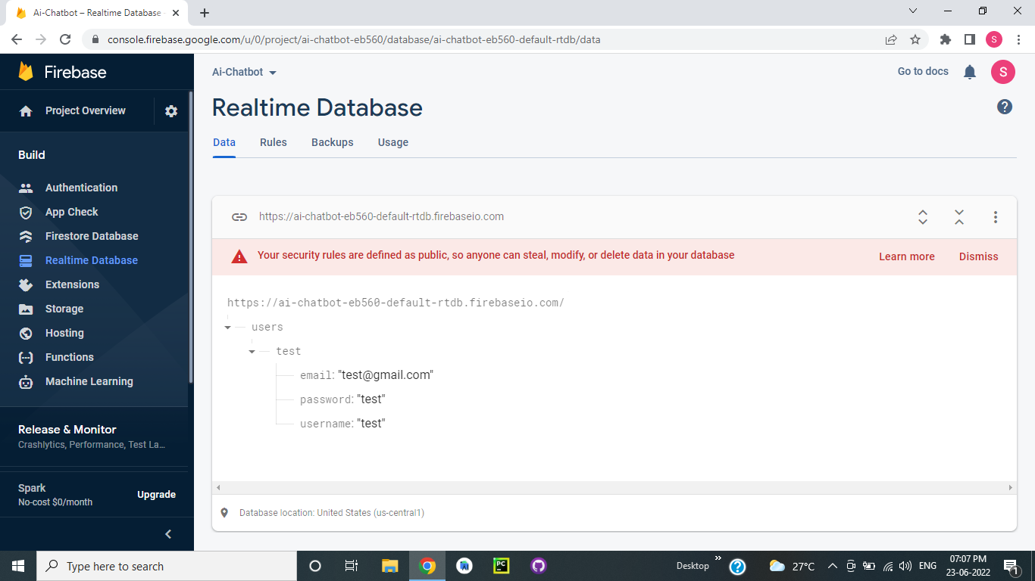
module 4 – integrating chatbot with database

Slide 14
CONCLUSION
Difficulties faced by the non-college members are eradicated through this chatbot. As all the details regarding the college are fed into the dataset, human intervention is reduced and provides high efficiency. Authentication facility of the website avoids misuse of the chatbots. These chatbots can be embedded into many college websites to reduce intervention of humans for providing all details.

Slide 15
FUTURE ENHANCEMENTS
The future enhancements can be done by using the voice recognition mechanism and the bot can be deployed in various social channels and it can be made to implement in different languages.

Slide 16
REFERENCE
Shafquat Hussain, Omid Ameri Sianaki, and Nedal Ababneh, “A Survey on Conversational Agents/Chatbots Classification and Design Techniques”
Shahriare Satu, Hasnat Parvez and Shamim-AI-Mamun, “Review of integrated applications with AIML based chatbot”
Gwo-Jen Hwang & Ching-Yi Chang,” A review of opportunities and challenges of chatbots in education”
Tatwadarshi P. Nagarhalli, Vinod Vaze and N. K. Rana,” A Review of Current Trends in the Development of Chatbot Systems”
AM Rahman, Abdullah Al Mamun and Alma Islam.” Programming challenges of Chatbot: Current and Future Prospective”

Slide 17
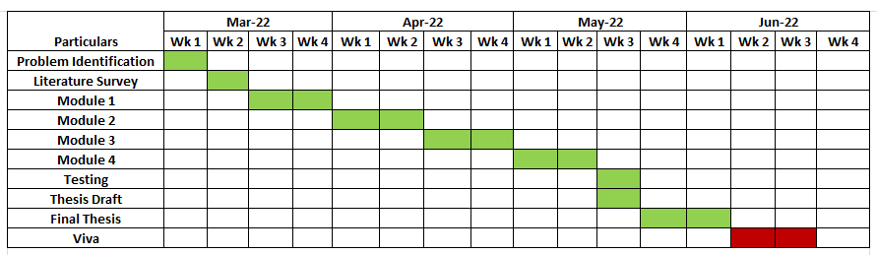
TIMELINE

Slide 18
THANK YOU

